Slide 1

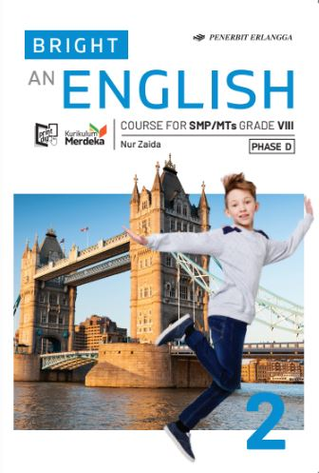
MEDIA MENGAJAR
BRIGHT AN ENGLISH
FOR SMP/MTs GRADE VIII

Slide 2
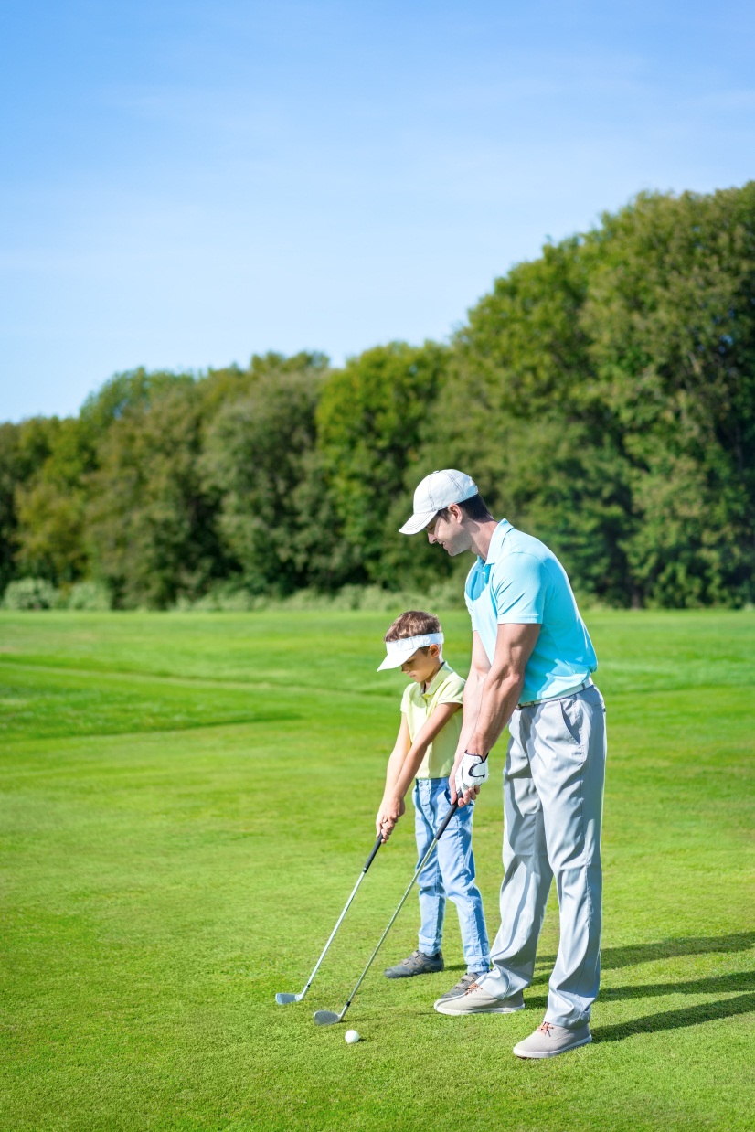
Chapter 2
I Play Golf on Weekends
Notes:
Jika terdapat gambar cantumkan sumber gambar dgn ukuran font 10pt

Slide 3
A. ……….
In this chapter, we will learn to:
talk about things that are true in general;
identify and use the simple present tense in the positive, negative, and interrogative forms;
ask and answer whether something is the case or not;
state things that happen regularly;
write routines.

Slide 4

The Simple Present Tense
We use simple present tense to tell about something true in general and habits. We can also use simple present tense to ask whether something is the case or not.

Slide 5
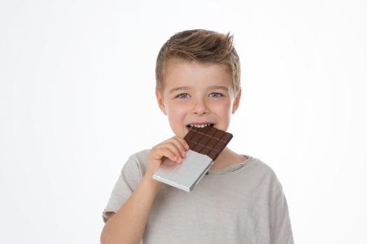

Look at the pictures. Read the sentences.
I’m looking at my books.
I read a lot.
He’s eating a chocolate bar. He likes chocolate.
The sentences in blue are written in the simple present tense.
We use the simple present tense to tell things that are true in general,
or for things that happen sometimes or all the time:
• I like small cities.
• The shops open at seven o’clock.

Slide 6
Here is further explanation about it:
Verbs have different forms, called tenses. The tense of a verb tells you when the action happens. If it happens regularly, or if it happens often or sometimes or never, you use the simple present tense.
Most people eat three meals a day.
I often help Dad wash the car.
When you are talking about facts, or saying something you know about
a person or thing, you use the simple present tense.
Penguins live in Antarctica.
Sharon often visits the Louvre Museum in Paris.

Slide 7
Here is more explanation about it:
The Third Person Singular
You put –s at the end of a verb when you use the verb with the pronouns he, she and it, and with singular nouns. The –s form of the verb is known as the third person singular.
He sings well.
She likes ice cream.
Spell Well
Here are more third person singular verbs ending in –s.
shakes eats digs builds opens rides
falls paints rains talks takes enjoys
looks jogs plays cooks reads breaks

Slide 8

Here is more explanation about it:
Spell Well
Here are more third person singular verbs ending in –s.
shakes jogs opens rides
falls digs takes enjoys
looks rains reads breaks
eats plays talks thinks
paints builds cooks helps
For some verbs you add –es instead of –s for the third person singular.
Sue brushes her teeth after each meal. She sometimes watches TV after dinner.
NEXT

Slide 9
Here is more explanation about it:
Spell Well
Here are more third person singular verbs that end in –es.
kisses brushes passes
dresses rushes fixes
washes wishes cashes
misses buzzes crashes
hisses marches fetches
You drop y and add –ies to form the third person singular of verbs that end in –y.
A cat carries its kittens in its teeth.
Tom usually fries an egg for breakfast.

Slide 10
Here is more explanation about it:
But for some verbs that end in -y, you don’t drop the y if there is the vowel a, e, o or u before it.
You just add –s after the y.
Sarah always buys a magazine to read on the train.
Anna stays with her aunt on weekends.

Slide 11
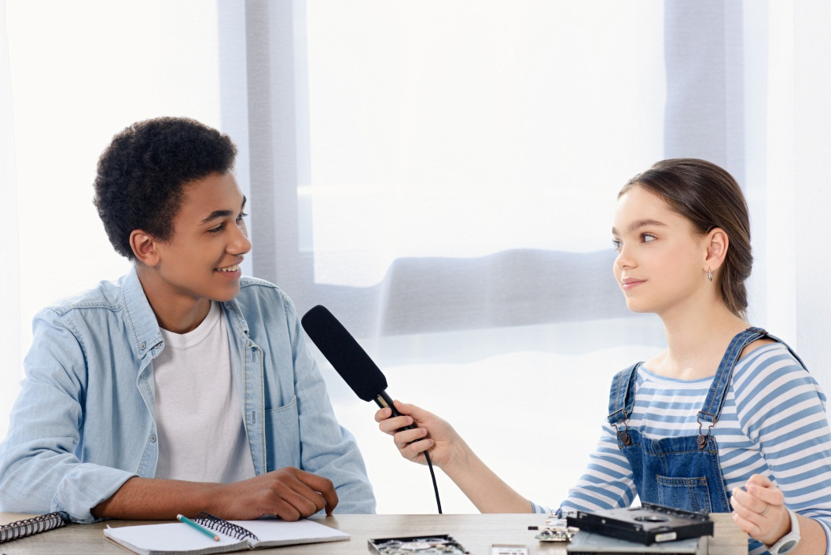
Listen to an interview with a young entrepreneur, Harlee Jordean. He is only 11 years old, but he has his own business. He is the Marble King.
Reporter : Good morning, Harlee.
Harlee : Good morning.
Reporter : You are famous as a young entrepreneur. Congratulations.
Harlee : Thank you.
Reporter : What do you sell, Harlee?
Harlee : I sell marbles. My customers are from many countries all around the world.
Reporter : You must be very busy.
Harlee : Yes, I have a lot of orders from the customers.
Reporter : Wow! How do you manage your time?

Slide 12
Listen to an interview with a young entrepreneur, Harlee Jordean. He is only 11 years old, but he has his own business. He is the Marble King.
Harlee : Well, I usually start my day at seven. I have a shower and have breakfast with my parents.
Reporter : What time do you go to school?
Harlee : I usually go to school at eight. School starts at nine and finishes at two.
Reporter : What do you usually do after school?
Harlee : Well, I’m back to business. I check my website to see the orders.
Reporter : Who helps you?
Harlee : My mother helps me. She manages the delivery. We deliver our marbles twice a week.

Slide 13
Positive
Negative
I We You They | play like do have
He She It | plays likes does has
I We You They | do not (don’t) | play like do have
He She It | does not (doesn’t)
Examples:
• I read comic books but I don’t read novels.
• Salma reads comic books but she doesn’t read novels.
• You don’t study very hard.
• The weather in June is usually nice. It doesn’t rain very often.
• Ketut and Sandra don’t eat meat. They are vegetarians.

Slide 14
Simple Present Tense in Questions with Short Answers
Do | I We You They | play? like? do? have?
Does | He She It
Yes, | I We You They | do.
 | He She It | does.
No, | I We You They | don’t.
 | He She It | doesn’t.
or

Slide 15
GOOD JOB!

